Slide 1



Slide 2



Error/ Warning
Information
Flashback
Class Exercise

Slide 3
Table of Content
What is Apache Spark
MapReduce vs Spark
Apache Spark Ecosystem
History of Apache Spark
Spark Pillars
Resilient Distributed Dataset (RDD)
Direct Acyclic Graph (DAG)
RDD Operations
Spark Cluster Architecture
Spark Application Lifecycle
Terminologies

Slide 4
Apache Spark is a unified analytics engine for large-scale data processing and machine learning

Slide 6
Unified Analytics Engine

Slide 7










Evolution of Unified Analytics Engine
2004 -
2007 -
2014 -
Batch Processing
Faster Processing
Unified Platform
Batch Processing
Interactive, Machine Learning, Real time
Interactive Queries
Iterative, Streaming, Graph, SQL
Real-time Analytics
Machine Learning
Graph Processing

Slide 8
Data Growth
Information
Worldwide data is expected to hit 175 zettabytes by 2025
90 ZB of this data will be from IoT devices in 2025
71% of enterprises reported that unstructured data was growing “much faster” than other business data
80% of data will be unstructured by 2025
On top of business documents, video and audio are added new content such as social media, IoT, streaming and geo data
There will be 4.8 billion internet users by 2022, up from 3.4 billion in 2017
90% of all data in existence today was created in the past two years
More than 200 billion devices are projected to be generating data in the IoT trend
Source : Internet

Slide 9
Spark
YARN
HDFS

Slide 10
Measurement of Data
Information
Abbreviation | Unit | Equivalent
B | Byte | 8 Bits
KB | Kilobyte | 1024 Bytes
MB | Megabyte | 1024 Kilobytes
GB | Gigabyte | 1024 Megabytes
TB | Terabyte | 1024 Gigabytes
PB | Petabyte | 1024 Terabytes
EB | Exabyte | 1024 Petabytes
ZB | Zettabyte | 1024 Exabytes
YB | Yottabyte | 1024 Zettabytes
BB | Brontobyte | 1024 Yottabytes

Slide 11
Apache Spark
Open Source from Apache Software Foundation
Flexibility – Scala, Python, Java, SQL and R
In-memory, Distributed and Parallel Processing
Batch and Streaming
Ease of use
Better Analytics – SQL queries, ML algorithms
Runs on Standalone Cluster, Apache Hadoop YARN, Apache Mesos, Kubernetes
Connects to hundreds of data sources

Slide 12
SAP/Mainframes
NoSQL
MongoDB
Cassandra
RDBMS
MySQL/Oracle etc
CSV/JSON/XML/PARQUET/ORC/AVRO
Hive
Cloud stores
Amazon S3
Spark
Hadoop

Slide 13
Spark
MapReduce
Spark
Spark
Spark Standalone Cluster Manager
MESOS
YARN
Distributed Storage
Distributed Storage
HDFS

Slide 14
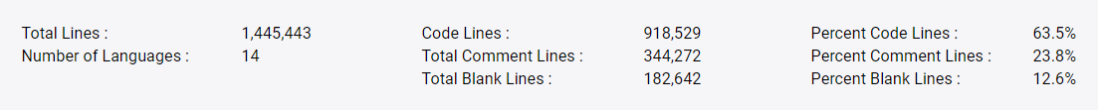
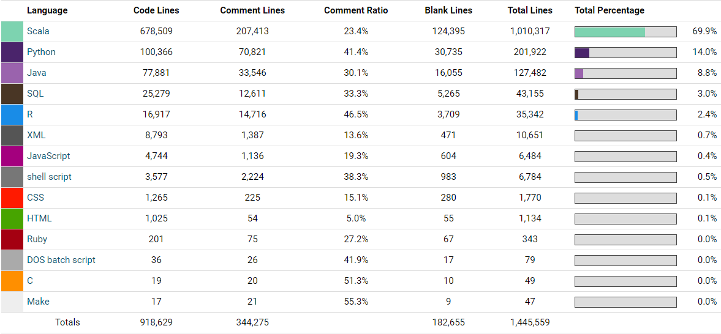
Building Apache Spark
Source : https://www.openhub.net/p/apache-spark/analyses/latest/languages_summary

Slide 15
MapReduce vs Spark
Factors | Apache Spark | MapReduce
Speed | 10 – 100 times faster | Faster than traditional systems
Written using | Scala (69.9%), Python (14%), Java (8.8%), SQL (3%), R (2.4%) | Java
Data Processing | Batch / Iterative / Interactive / Real-time / Graph | Batch
Complexity | Compact and Simple to use | Complex and Lengthy
Cache | In-memory/Disk Caching | More Disk IO and Minimal Caching

Slide 16




Beyond MapReduce
MapReduce - Batch Processing
MapReduce - No support for Real-time, Interactive, In-memory, Machine Learning and Graph data
Spark - To handle all workloads. It offers
In-memory data caching - scan HDD only once, then all IO operations performed in RAM
Efficient Pipeline
Lazy Evaluation - Execution will not start until an action is triggered

Slide 17
Apache Spark Ecosystem

Slide 18
Apache Spark Ecosystem
Spark SQL
+
DataFrames
Spark Streaming
ML Lib
+
Machine Learning
GraphX
Spark Core API
Scala
Python
SQL
Java
R

Slide 19
Apache Spark History
Information
Started as a Research project at UC Berkeley
Donated to Apache Software Foundation (ASF) & Databricks Founded
DataFrame and Dataset APIs introduced
Apache Spark 3.0
2010
2014
2016
2009
2013
2015
2020
Open Sourced and First Research Paper Published
Spark 1.0
(Spark Core, Spark SQL, ML lib)
Release of Spark 2.0

Slide 20
Spark - Pillars
Resilient Distributed Dataset (RDD)
Directed Acyclic Graph (DAG)

Slide 21
textFile
Cloud
Book.txt
bookRDD
flatMap
aRDD
map
bRDD
cRDD
reduceByKey
Take(10)
count
collect
(Hadoop,100)

Slide 22
Caching the RDD
There is a transformation called cache() → Completely in memory
There is another transformation called persist()
DISK_ONLY
MEMORY_ONLY
MEMORY_AND_DISK
DISK_ONLY_WITH_SER
MEMORY_ONLY_WITH_SER

Slide 23
Datanode-3
Amazon Cloud
Sales.csv(6 GB)
Executor-1
3 GB RAM
3 CPU
P0
Datanode-1
P1
P2
Driver Program
TASK
YARN
Datanode-2
P0
P1
P2
SparkContext
TASK
P3
P4
P5
P3
The file Sales.csv is now divided into 6 partitions. Each partition size is 1 GB
Executor-2
3 GB RAM
3 CPU
P4
P5
Spark Program

Slide 24
Datanode-3
Your data is lying as 6 partitions in 2 machines. How do you represent your data in a program?
I cannot represent the data as an array or a list or any other collection
a = P0+P1+P2+P3+P4+P5
Here, a is an RDD
RDDs are immutable
RDDs are also lazily evaluated
RDD (Resilient Distributed Dataset)
Typical Spark Program
-------------------------------
a = sc.textFile(“sales.csv”)
b = a.map (func)
c = b.filter(func)
c.collect
Transformations and Actions
Executor-1
3 GB RAM
3 CPU
P0
Datanode-1
P1
P2
Driver Program
YARN
Datanode-2
SparkContext
P3
Executor-2
3 GB RAM
3 CPU
P4
P5
Spark Program

Slide 25
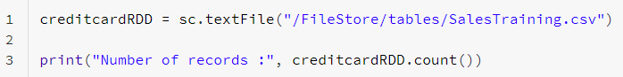
Resilient Distributed Dataset (RDD)
Data read from a file will form a single RDD
RDDs are divided into logical partitions, which are stored on different worker machines of the cluster
RDD is an immutable, distributed across nodes
Fault tolerant – using DAG (Lineage)
Partitions can be persisted in-memory or disk
Lazily Evaluated and Executed

Slide 26

Resilient Distributed Dataset (RDD)
Resilient (Fault Tolerant) – when the data in memory is lost, it can be recreated
Distributed - stored in memory across the worker nodes of the cluster
Dataset - file/created programmatically
RDDs are the fundamental unit of data in Spark
pointer to parent
transformations
(map, filter..)
RDD
(Immutable)
New RDD
(Immutable)
actions
(collect, count..)
Driver Node

Slide 27
Direct Acyclic Graph (DAG)
Sequence of computations performed on data
Node - Where RDD partitions resides
Edge - Transformation of top of data
Acyclic - Can’t return to the old partition
Direct - Transformation is an action that transitions data partition state (from A to B)
Lineage - Shows dependency between RDDs
RDD 1
Transformation
RDD 2
RDD 4
RDD 3
Stage
RDD 5
Action

Slide 28
Spark Program Lifecycle
Spark Session
Data
Transformations
RDDs
Actions

Slide 29
RDD Operations - Transformations
Transformations create a new RDD from an existing RDD
RDDs are immutable
Data in an RDD can’t be changed
Transformations are performed in sequence to modify the data as needed
Common Transformations
map() - creates a new RDD by performing a function on each record of the parent RDD
filter() - applies a boolean function on each record of the parent RDD to include/exclude records and creates a resultant RDD
Types
Narrow Transformations
Wide Transformations
transformations
(map, filter)
Old RDD
(Immutable)
New RDD
(Immutable)
Source data

Slide 30
Transformations
Narrow Transformation (filter)
Wide Transformation (reduceByKey)
CAT DOG MAN
CAT
CAT DOG MAN
CAT
CAT DOG MAN
CAT
CAT DOG MAN
DOG
CAT DOG CAT
CAT
CAT DOG CAT
MAN
CAT DOG MAN
CAT
CAT DOG MAN

Slide 31
RDD Operations - Actions
Actions return a value to the Driver program after running a computation on the dataset
Some common actions are
count() - returns the number of elements
take(n) - returns an array to the Driver program having first ‘n’ elements
collect() - returns an array of all the elements
saveAsTextFile(filename) - save the elements to text file
transformations
(map, filter)
Old RDD
(Immutable)
New RDD
(Immutable)
Driver Node
Source data
actions
(count, collect)

Slide 32
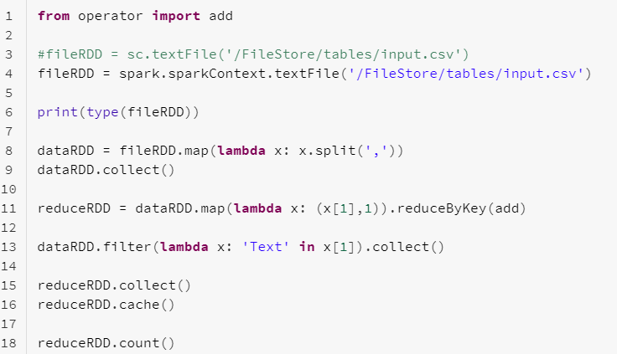
A Sample Spark Application
Import library
RDDs
Transformation
Transformation
Transformation
& Action
In-memory
Action

Slide 33
RDD Lineage
When a transformation is called, Spark does not execute it immediately (lazy evaluation), instead it creates a lineage
Lineages in the form of DAG, used by the Driver program to perform sequence of computations on data
fileRDD = spark.sparkContext.textFile('/FileStore/tables/input.csv')
dataRDD.collect()
lineage
transformation
(map)
fileRDD
(Immutable)
dataRDD
(Immutable)
Driver Node
Source data
actions
(count)
dataRDD = fileRDD.map(lambda x: x.split(','))

Slide 34
Spark - Data Pipelines
Streaming Applications
NoSQLs
RDBMS
Data Lake Storages
Many More..
Hadoop FS
Cloud Object Stores
Data Warehouses

Slide 35
Spark Cluster Architecture
Worker Node 1
Memory
Memory
Executor 1
Executor n
Task
Task
Task
Task
Cluster Manager
Driver Program
Spark Session
Worker Node n
Memory
Memory
Executor 1
Executor n
Task
Task
Task
Task

Slide 36
Apache Spark Architecture
Master-Slave Architecture
One central coordinator called Spark Driver, which communicates with Workers
Each Worker Node consists one or more Executor(s) responsible for executing the tasks (Transformations, Actions) assigned by the Driver program
Working combination of Driver and Executors makes the Spark application
The Spark application relies on Cluster Manager for allocating Worker Nodes. The Cluster Manager can be:
Apache Yarn
Standalone Spark Cluster
Apache Mesos
Kubernetes

Slide 37
Apache Spark Architecture - Driver Program
The Driver program creates SparkSession object, which allocates and coordinates tasks of the Spark application
Converts the code to tasks and determines number of tasks
Helps creating DAG, lineage, logical and physical plans
Connects with Cluster Manager, which allocates resources (in Worker node) for the Spark application
Acquires Executors in Worker Nodes
Sends the Application code and tasks to the Executors to run
Works with Executors for completing the Spark application

Slide 38
Apache Spark Architecture - Executors
Executors resides in the Worker node
Each Executor has its own computation resources for executing the tasks
Worker node can have one or more Executors
Responsible for executing the tasks assigned by the Driver program
Distributed Parallel Processing - Each Executor runs the code individually and parallelly
Sends the output to the Driver program
Caches the data in-memory, which enables faster processing
Upon completion of the Spark application, all the assigned Executors are released

Slide 39
Spark Application - Life Cycle
2
4
Worker Node
Spark submit launches Driver
Drivers connects with CM for resources
Memory
Executor
Driver Program
Task
Task
6
SparkSession
Datasets
Transformations
Actions
Cluster Manager
Executors run the tasks
Worker Node
Memory
Executor
User submits Spark application
Driver creates SparkSession
CM launches Executors for Driver
Task
Task
1
3
5
When Driver main() exits, all the resources are releases
7

Slide 40
Terminologies
Information
Driver Program
Java Virtual Machine (JVM) allocated to start the execution of main()
Creates SparkSession
SparkSession
Tells how to access the cluster components
Cluster Manager
Service to manage and allocate the resources on the cluster
Deploy Mode
cluster - Driver program runs in one of the cluster Worker nodes
client - Driver runs outside of cluster

Slide 41
Web Server
App Server
Chat Server
CRM Server
Kafka
Spark
NoSQL
Security
System

Slide 42
Terminologies
Information
Worker Node
A place, where Executor resides
Executor
JVM launched by the Worker node to execute the tasks from Driver
Will have computation resources
Keeps data in memory or disk when reading from external resources
Job
Collection of Stages
Stage
Each Job can have one or more Stages
Stages are executed sequentially
Each Stage has tasks
Task
Unit of work, which is sent to the Executor
Partition
Data unit what will be handled parallelly

Slide 43

Databricks

Slide 44
Table of Content
What is Databricks?
Databricks History
Working with Databricks Community Edition
Spin up a Cluster
Create a new Notebook
Writing Spark Programs
Uploading files to DBFS
How Spark Works in the Background?
Class Exercise

Slide 45
Databricks
Databricks is headquartered in San Francisco, California and was found by the creators of open source projects, including Apache Spark, Delta Lake, MLflow and Koalas
Cloud based Data Analytics platform for processing and transforming large quantities of data
Apache-Spark based platform
Runs a distributed system behind the scenes to enable distributed parallel processing for handling massive workloads
Available in AWS, Azure and GCP
Supports commonly used programming languages like Scala, Python, R, and SQL
Integrates easily with other Cloud services
Supports various file formats, connects with hundred of data sources
Growing community, extensive documentation and support
Thousands of global customers

Slide 46
Databricks History
Databricks founded by the creators Apache Spark
Microsoft announce Azure Databricks (preview)
Databricks launched in AWS cloud
Databricks made available in GCP
2014
2016
2018
2013
2015
2017
2020
Databricks beta launched AWS cloud
Databricks Community Edition made available
Azure Databricks launched for public

Slide 47
Databricks
Community Edition

Slide 48
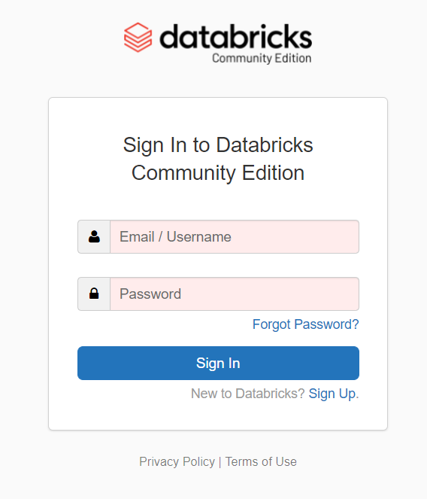
Databricks - Sign Up
1
Click “Sign In”

Slide 49
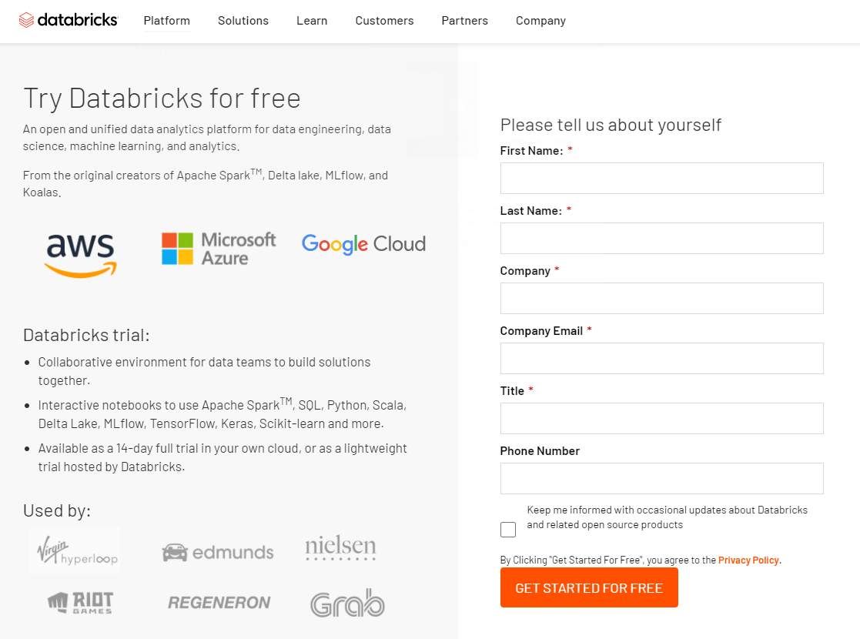
Databricks - Sign Up
2
Fill all the boxes and select
“GET STARTED FREE”

Slide 50
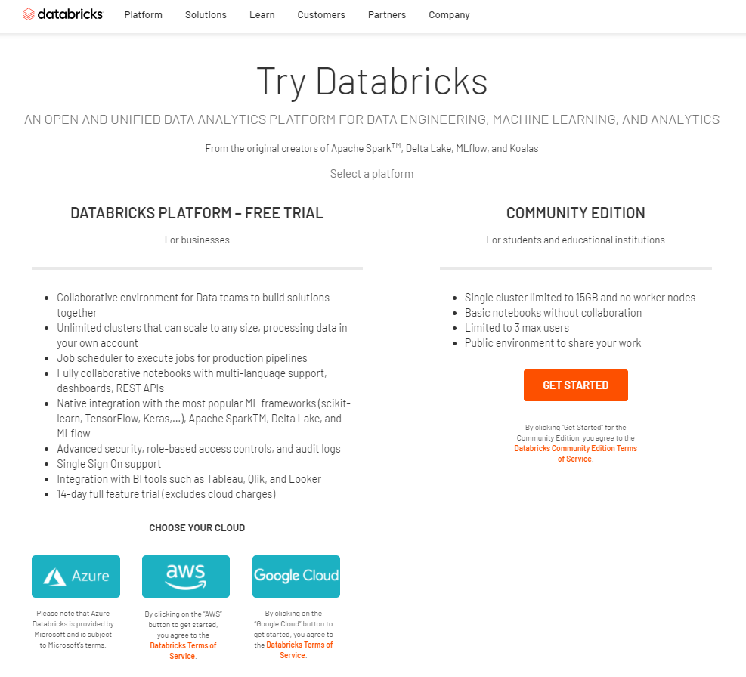
Databricks - Sign Up
3
Click
“GET STARTED”

Slide 51
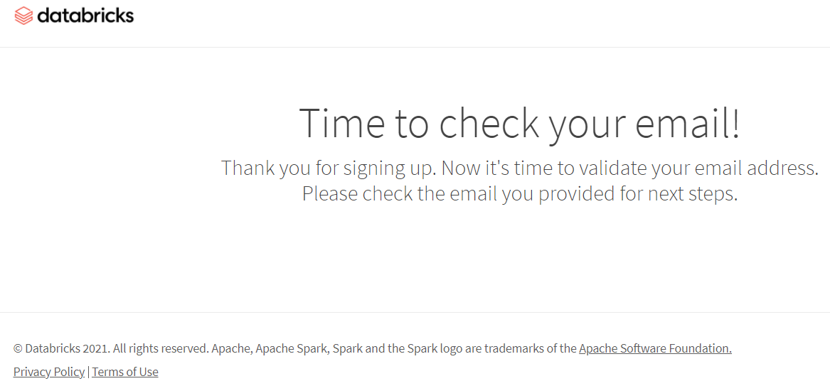
Databricks - Sign Up
4

Slide 52
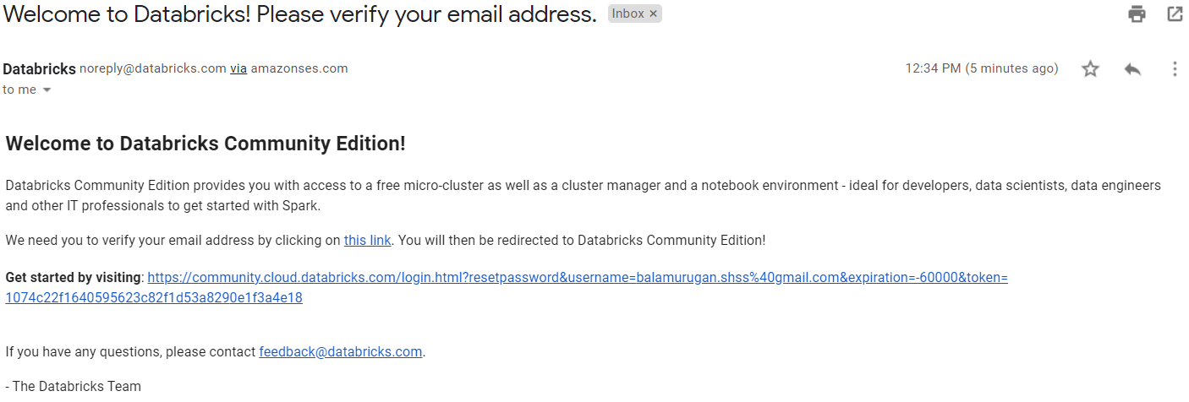
Databricks - Sign Up
5
Click the link

Slide 53
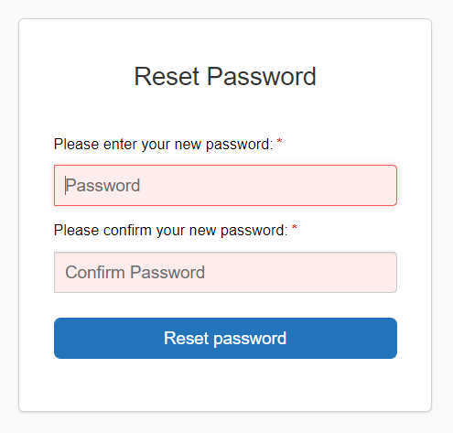
Databricks - Sign Up
6
Enter the “Password”
Confirm the “Password”
Click
“Reset Password”

Slide 54
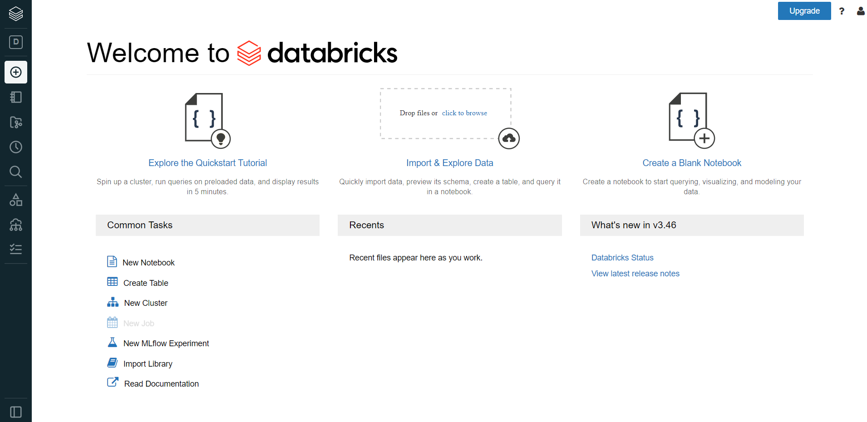
Welcome to Databricks

Slide 55
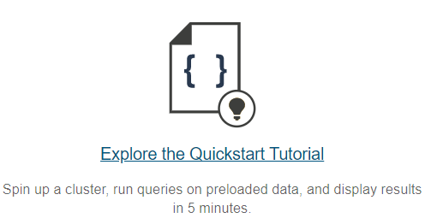
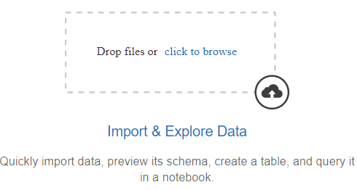
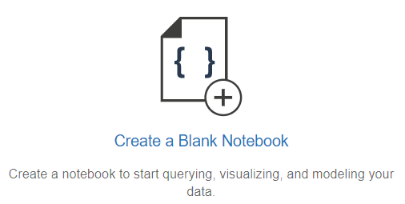
Working in Databricks
Spin up a cluster
Load the data
Create a notebook
Community Edition helps us to create a single node cluster. Both Driver and Executors will use the same node
Databricks support various file formats like csv, json, xml, text. It can also connect to various data sources
Databricks provide Jupyter Notebooks to write coding in Spark SQL, Python, Scala, R and Java

Slide 56
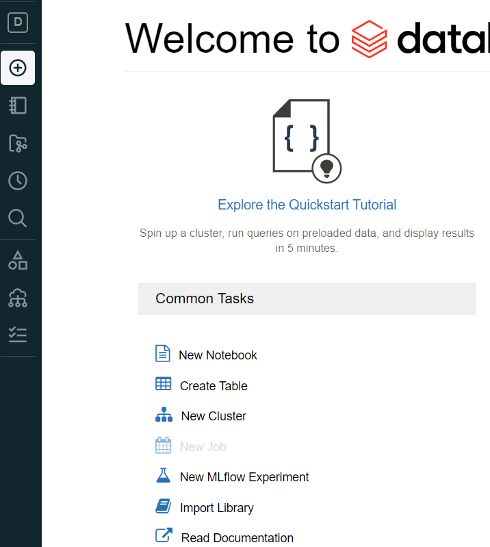
Spin up a cluster
1
Create
“New Cluster”

Slide 57
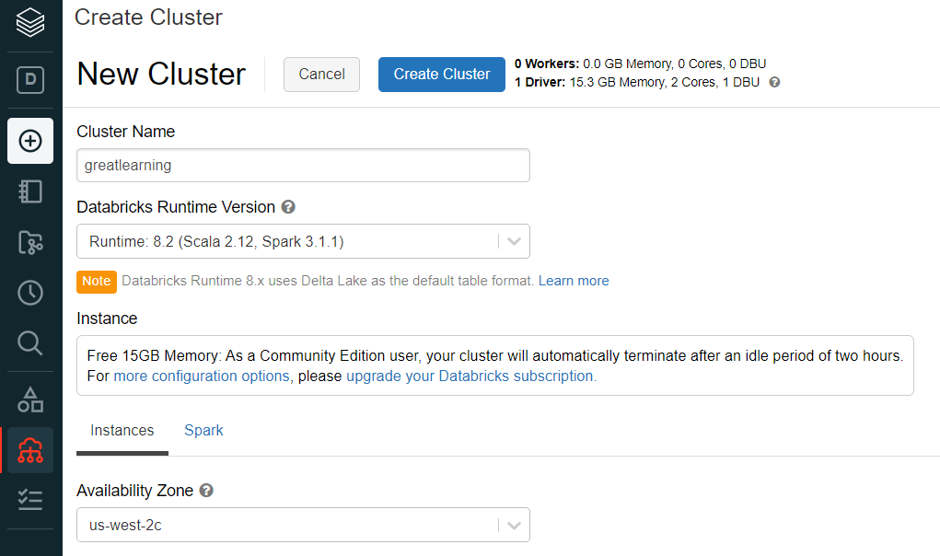
Spin up a cluster
2
Enter the cluster name
Choose the Databricks Runtime Version
Choose Availability Zone
Click “Create Cluster”
It creates a single node cluster with 15.3 GB memory, 2 cores
It takes a few minutes to create the cluster

Slide 58
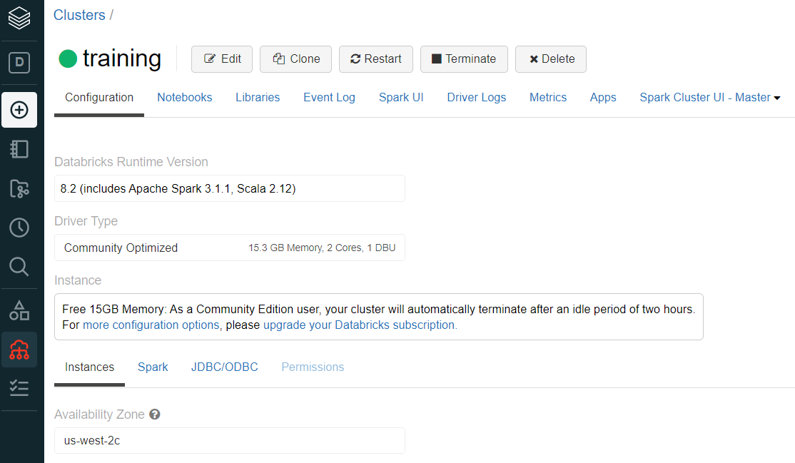
Spin up a cluster
3
Cluster is ready

Slide 59
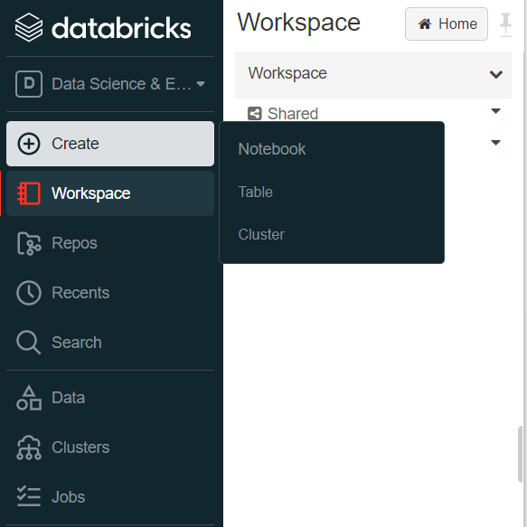
Create Notebook
1
Create
Click “Notebook”

Slide 60
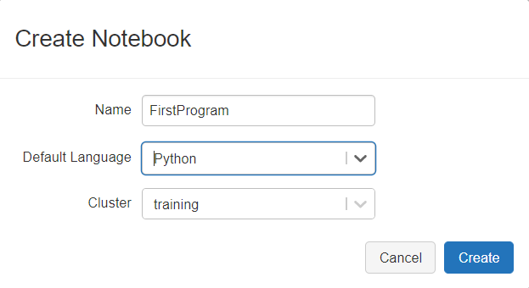
Create Notebook
2
Enter the Notebook name
Choose the language. Databricks CE support Python, Scala, R and SQL
Choose the Cluster. In CE, you can have only one cluster
Click “Create”

Slide 61
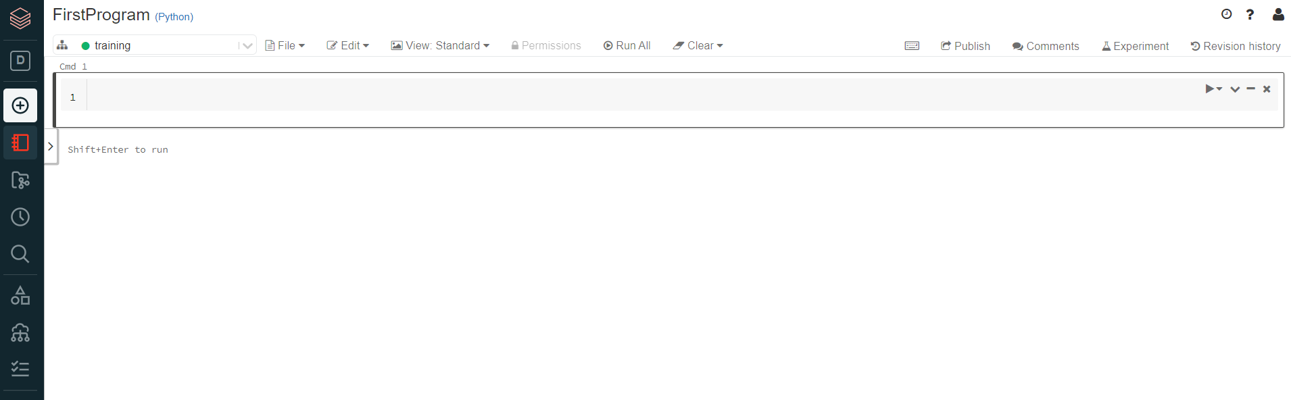
Create Notebook
3
Write you code here

Slide 62
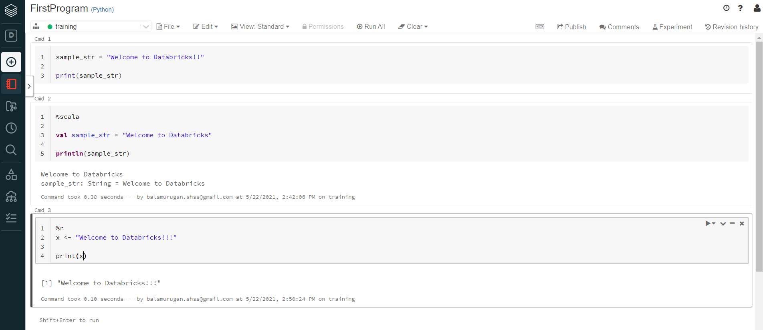
Write your first program
Control + Enter => will execute a single cell
Shift + Enter => will execute a single cell + creates a new blank cell
“Run All” will execute all the cells (highlighted in blue)
“Run” will execute a single cell
%python - python, %scala - scala, %sql - Spark SQL, %r - R

Slide 63
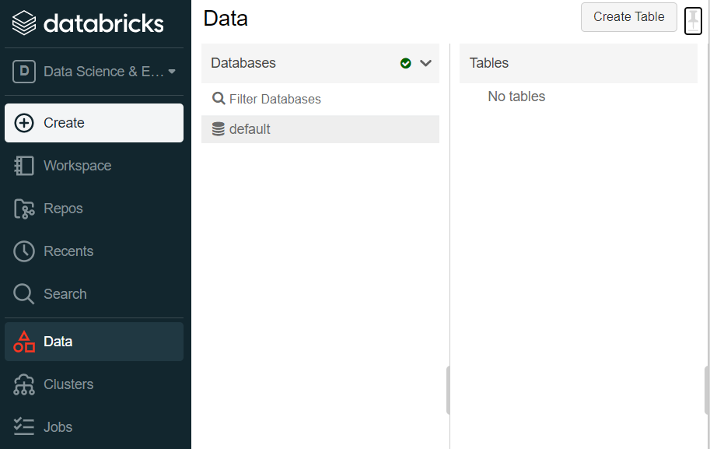
Loading file(s) to DBFS
2
Loading files to Databricks File System (DBFS)
Click “Data” tab
Click “Create Table”
1

Slide 64
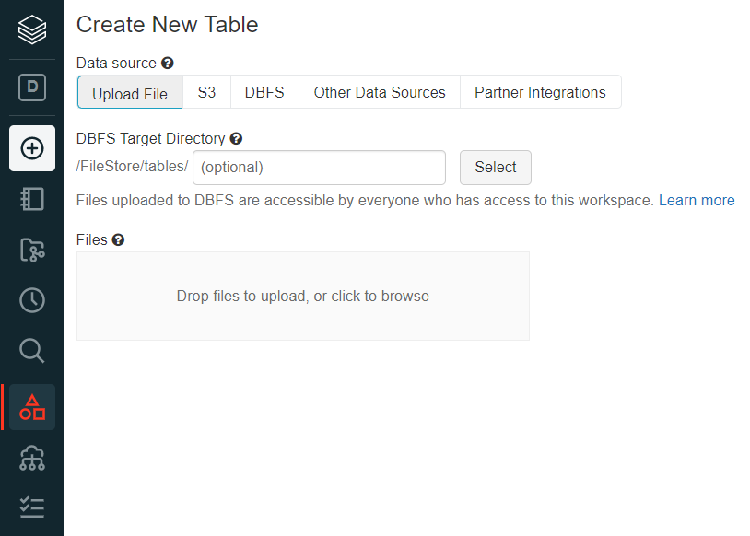
Loading file(s) to DBFS
Upload your files

Slide 65
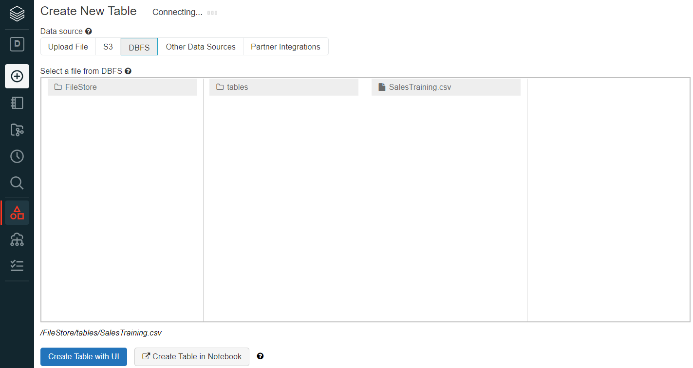
Loading file(s) to DBFS
File Loaded Successfully
Note : File loaded to “/FileStore/tables/SalesTraining.csv” (DBFS)

Slide 66
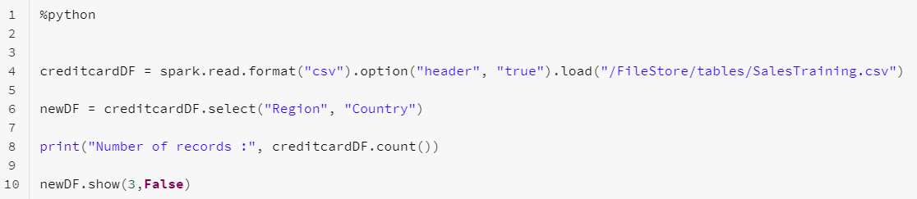

Working in Databricks
lineage
creditcardDF = spark.read.format(“csv”)
.load(“/FileStore/tables/input.csv”)
newDF = creditcardDF(“Region”, “Country”)
newDF.show(3, False)
Source data
creditcardDF
(Immutable)
newDF
(Immutable)
Transformation
Action
Driver Node

Slide 67

What happens in the background?
Source Data
Executor Cores - 4
Executor Memory - 20GB
Partitions
DataFrame
Task
Task
e.g. spark.read.format(“csv”)
Executor

Slide 68
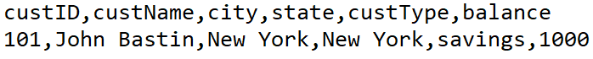
Class Exercise
Class Exercise
Create a CSV file with customer information (custID, custName, city, state, custType, balance) having a few records. Example:
Load the file in to DBFS (“/FileStore/tables/customer.csv”)
Create the RDD by reading the file using sparkContext.textFile method
Apply transformations like map, filter to create a new RDD having records with balance > 1000. Don’t include the header record in the new RD

Slide 69
Spark DataFrames

Slide 70
Table of Content
What is DataFrame in Spark?
Creating DataFrames
From RDDs
From various sources / datasets
DataFrameReader
Working with a CSV file
Defining your own Schema
Selecting DataFrame columns
Renaming columns
Adding and Dropping DataFrame columns
selectExpr
Handling null Values
DataFrame Aggregations
Coalesce vs Repartition
Cache vs persist
DataFrameWriter

Slide 71
Spark DataFrames
Immutable, distributed collection of data that is organized into rows and columns
Each column has a name and associated type
Similar to a table in RDBMS
Like RDD APIs, the DataFrame APIs are classified into 2 buckets : transformations, actions
Transformations are lazily evaluated, and actions are eagerly evaluated
DataFrame APIs are available in Scala, Python, Java and R
DataFrames can be created from existing RDDs, and data sources
Spark supports 6 built-in data formats - csv, parquet, json, jdbc, text and orc
DataFrames can be accessed by Domain-Specific Language (DSL)

Slide 72
Creating DataFrames
Creating DataFrames from RDDs
Creating DataFrame from Data Sources/External Datasets

Slide 73
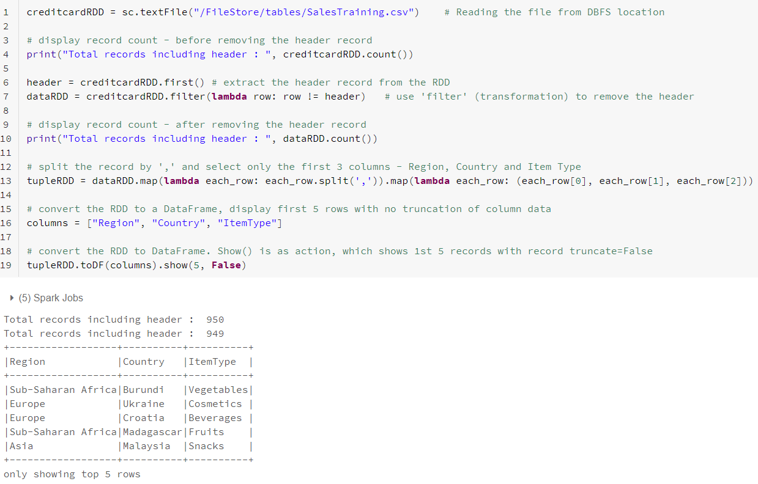
Creating DataFrames from RDDs

Slide 74
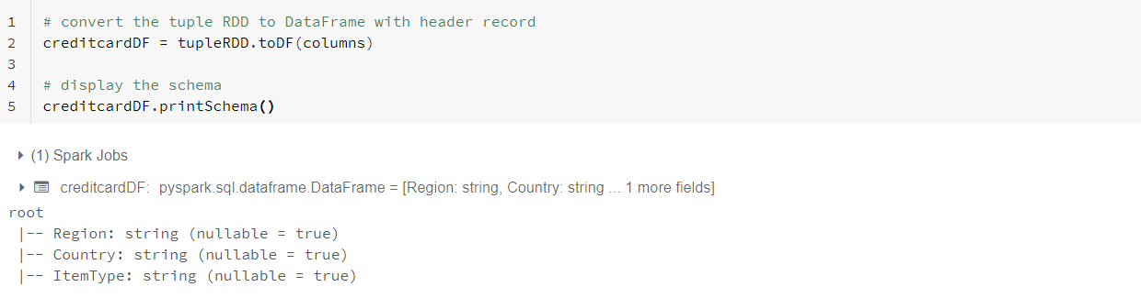
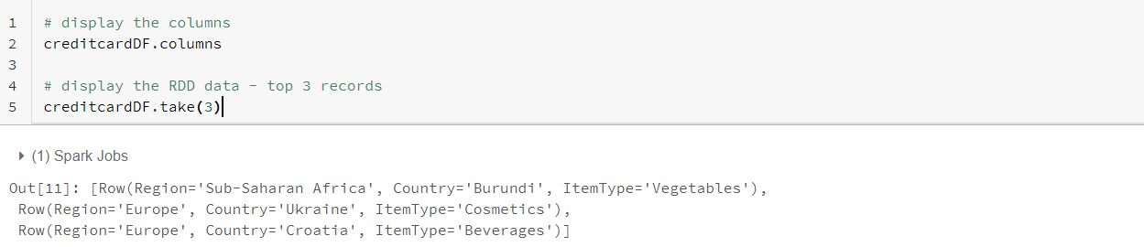
DataFrame Schema and Columns

Slide 75
Creating DataFrames from Data Sources
DataFrames can directly be created from various data sources or external datasets
Spark supports 6 built-in data sources, where each data source is mapped to a data format
Common formats for text data are CSV, XML and JSON
Common formats for binary data are Avro, Parquet, and ORC
The two main classes in Spark for reading and writing data are DataFrameReader and DataFrameWriter
DataFrameReader and DataFrameWriter are available with SparkSession

Slide 76
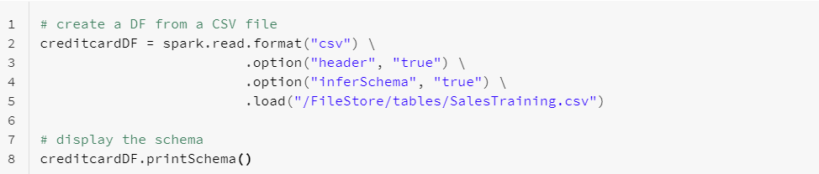
DataFrameReader
spark.read.format(...).option("key", value").schema(...).load()
format - json, parquet, jdbc, orc, csv, text
option - DataFrameReader has a set of default options for each data source format, which can be overridden
schema - Some data sources have the schema embedded inside the data files, i.e., Parquet and ORC. For other formats, provide a schema

Slide 77
Working with CSV files
1
One of the commonly used file formats
Databricks can connect and read data from number of sources like Cloud Storage Services, Databricks File System, HADOOP
Read the data using the DataFrameReader by passing all the necessary details
Apply DataFrame APIs to transform the data, push the data on to respective sources by executing the actions

Slide 78
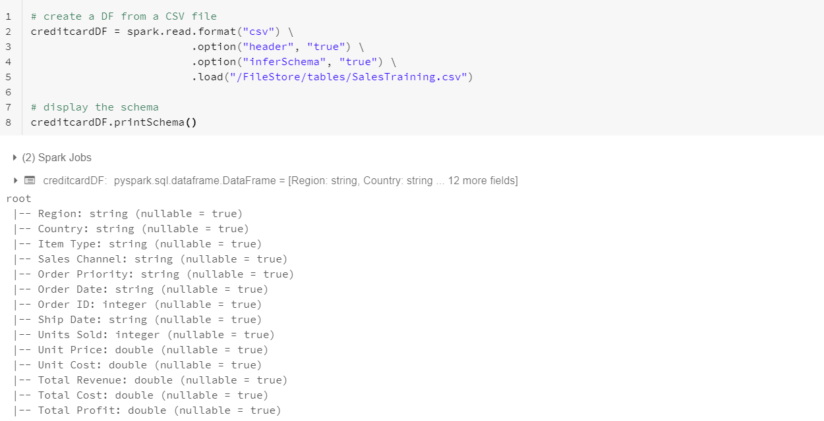
Working with CSV files
2
spark.read.format(..) returns the DataFrame object
Option “inferSchema” infers the schema for each column
Option “header” treats the first record as header record

Slide 79
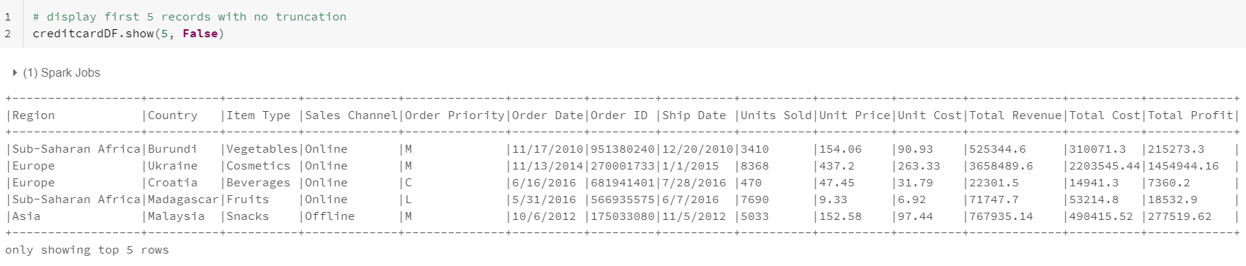
Working with CSV files
3
df.show(..) is an action, which brings the transformed data to the Driver node
Spark executes all transformations present in the Lineage (DAG), when an action is triggered

Slide 80
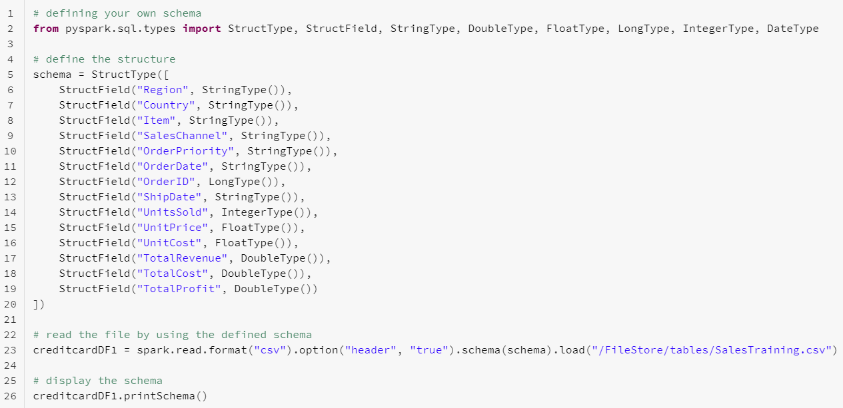
Defining Own Schema
1

Slide 81
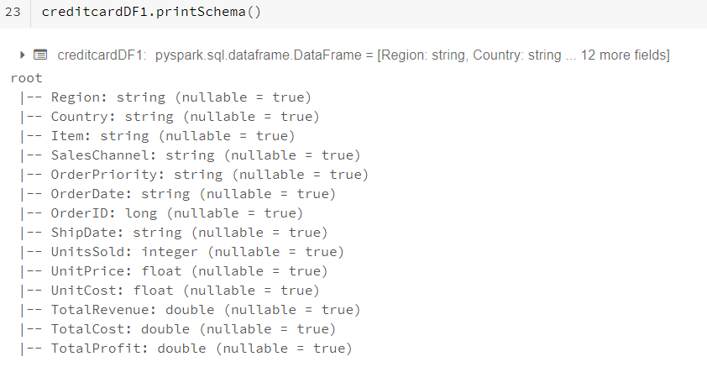
Defining Own Schema
2

Slide 82
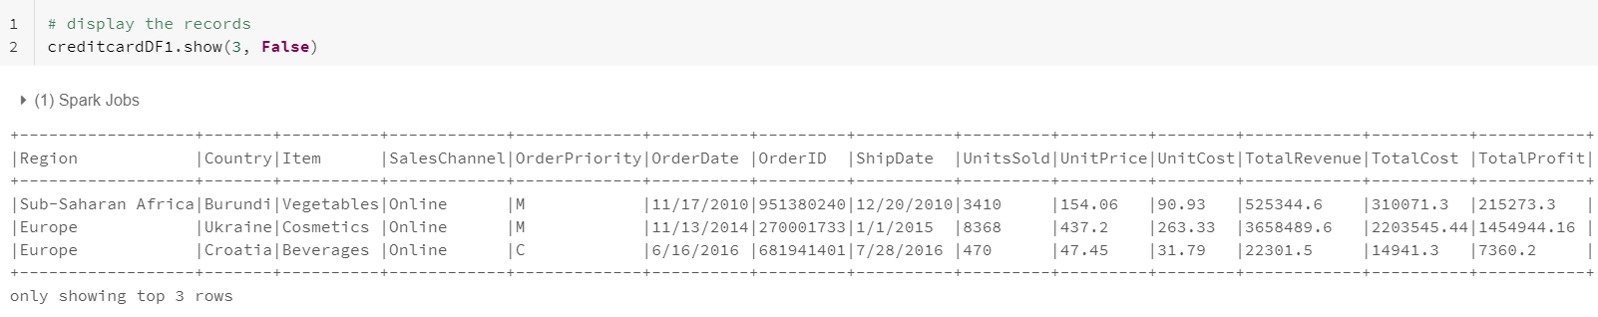
Defining Own Schema
3

Slide 83
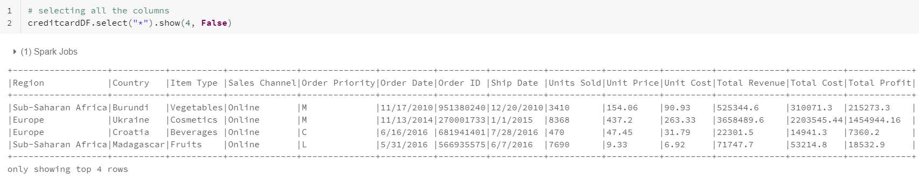
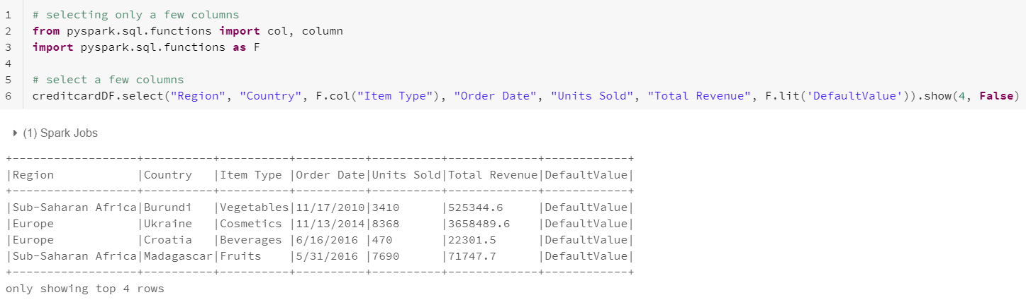
Selecting DataFrame Columns

Slide 84
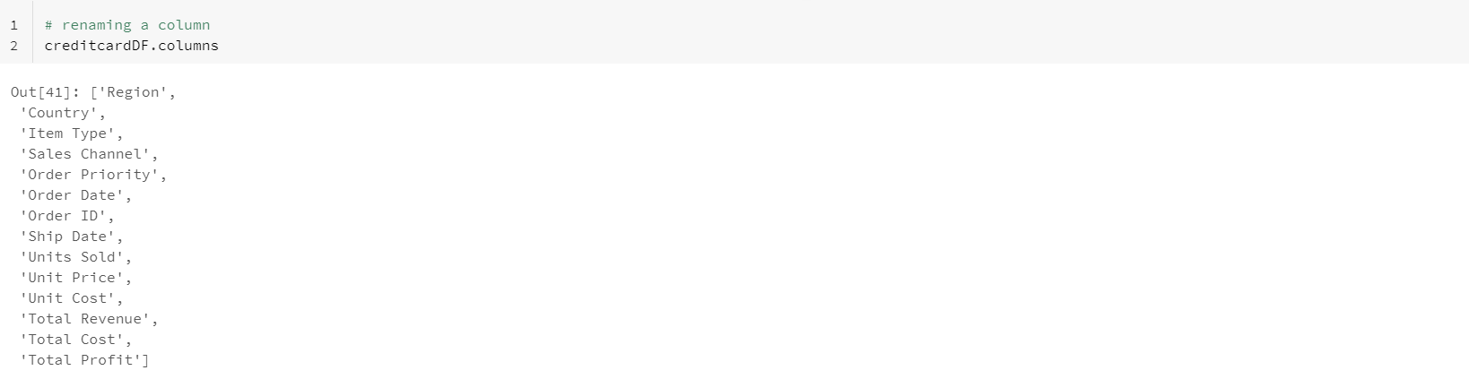
Renaming Columns
1

Slide 85
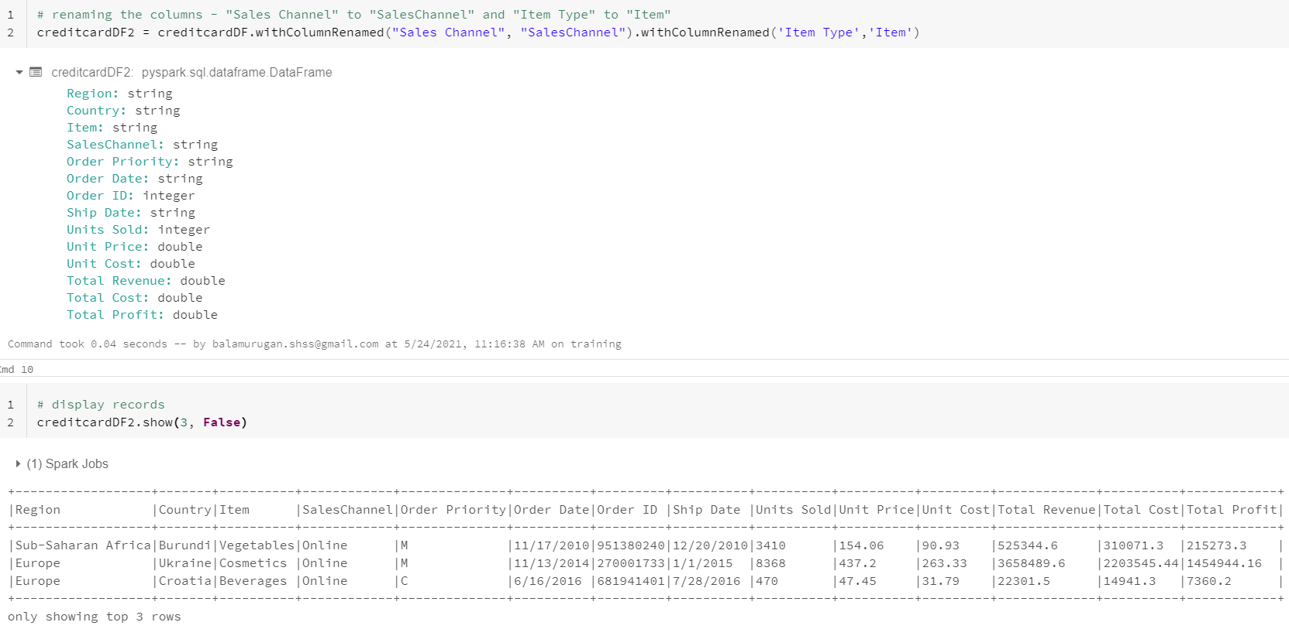
Renaming Columns
2

Slide 86
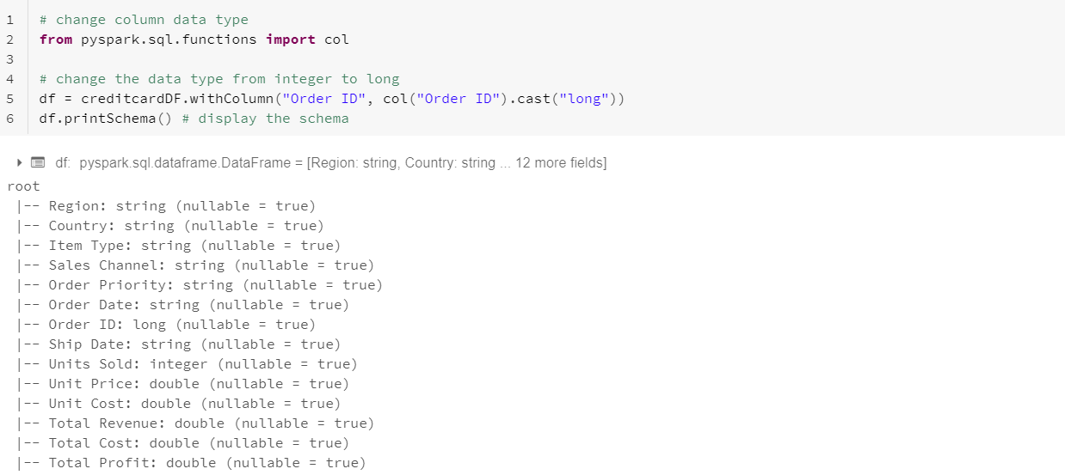
Changing Columns Data Type

Slide 87
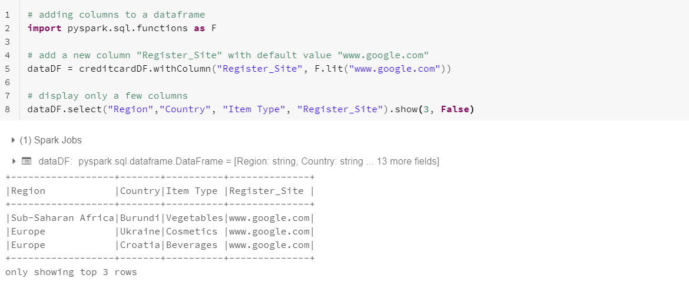
Adding Columns to a DataFrame

Slide 88
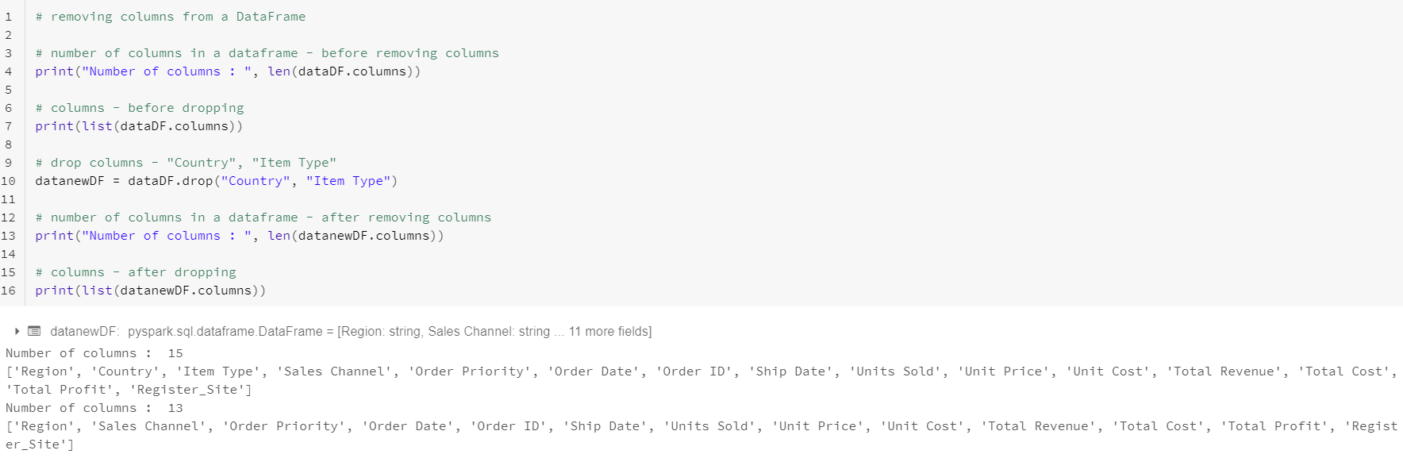
Removing Columns from a DataFrame

Slide 89
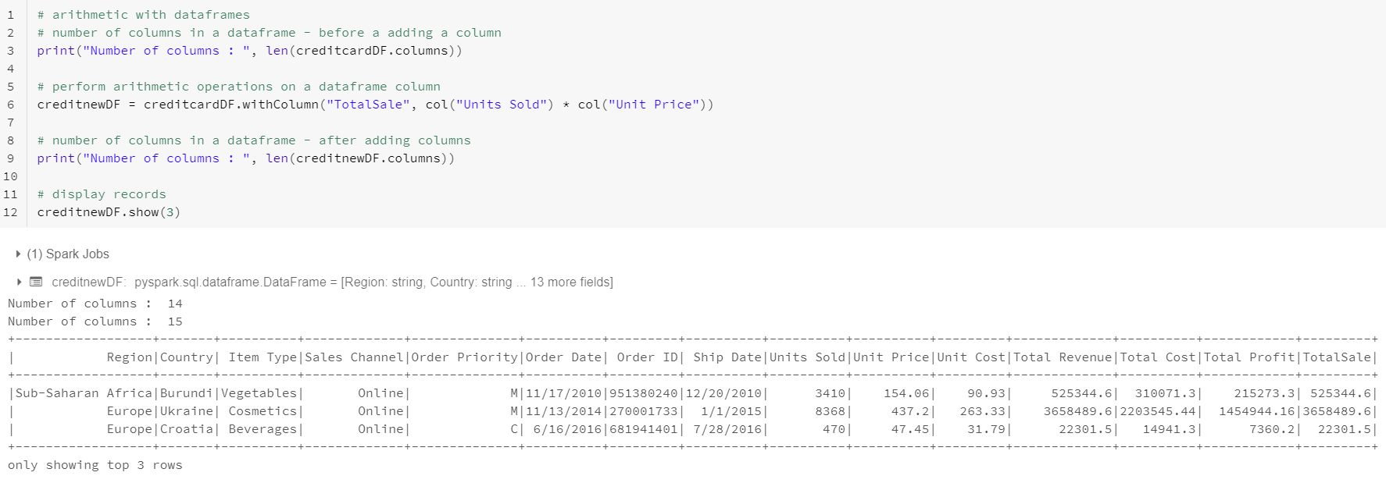
Arithmetic with DataFrames

Slide 90
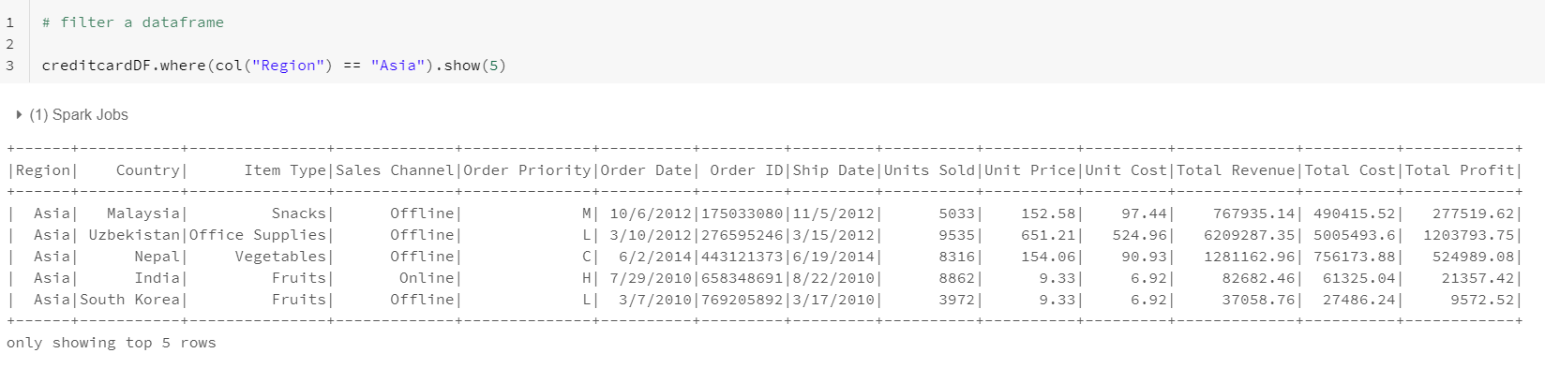
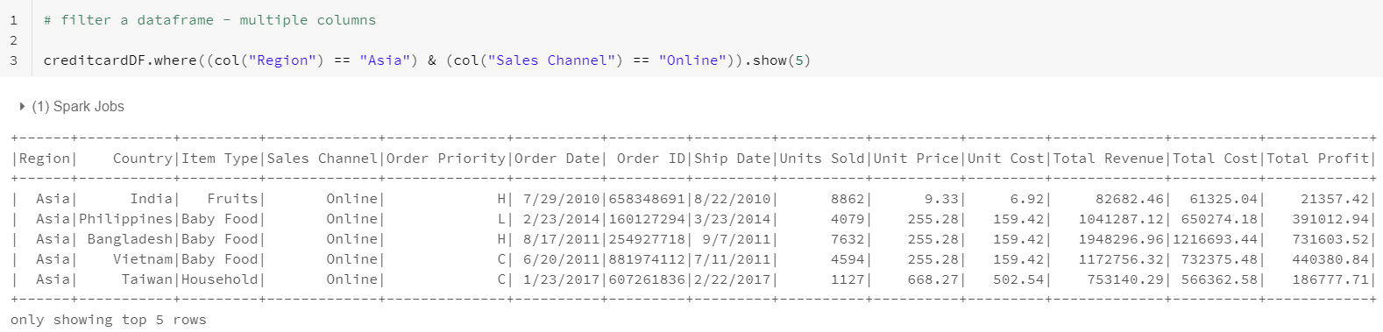
How to Filter a DataFrame

Slide 91
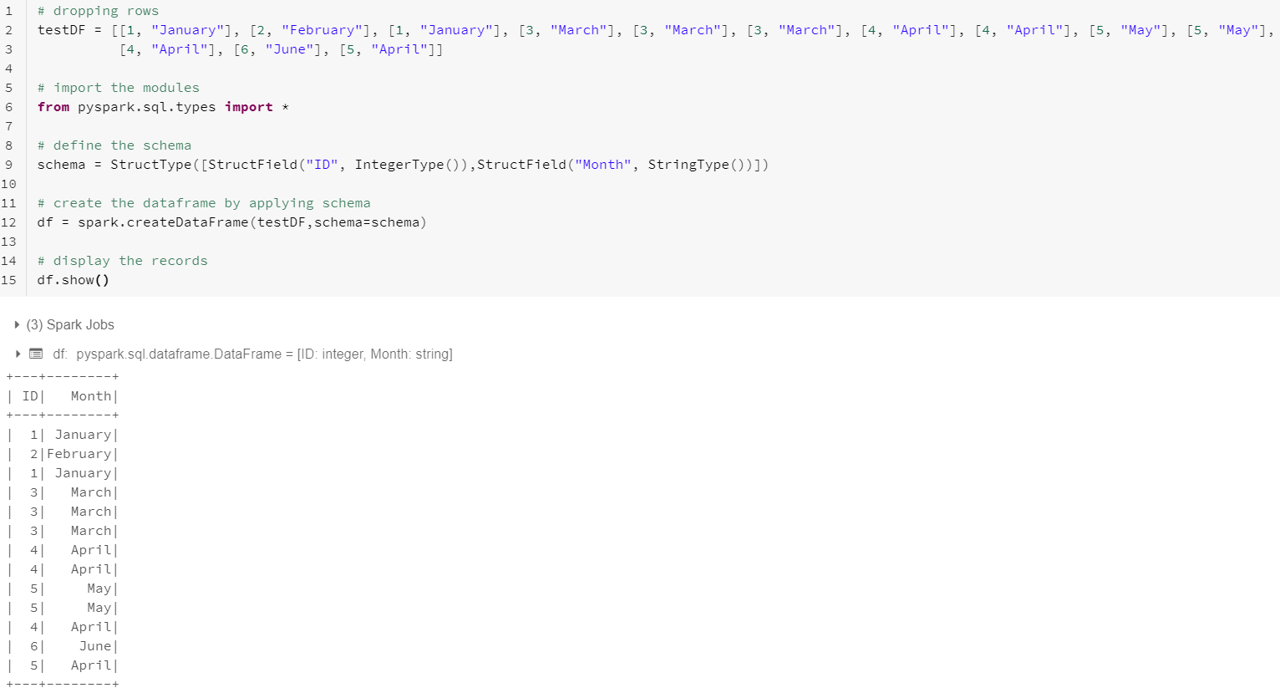
Dropping Duplicate Rows
1

Slide 92
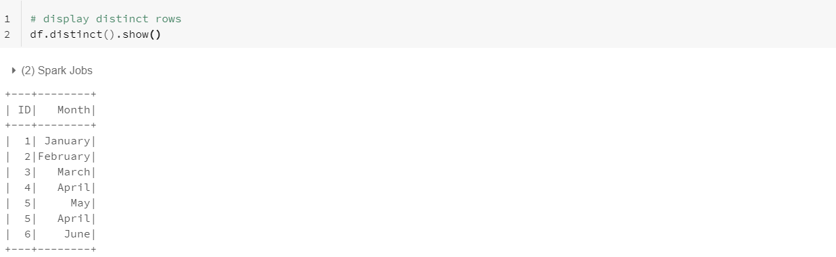
Dropping Duplicate Rows
2

Slide 93
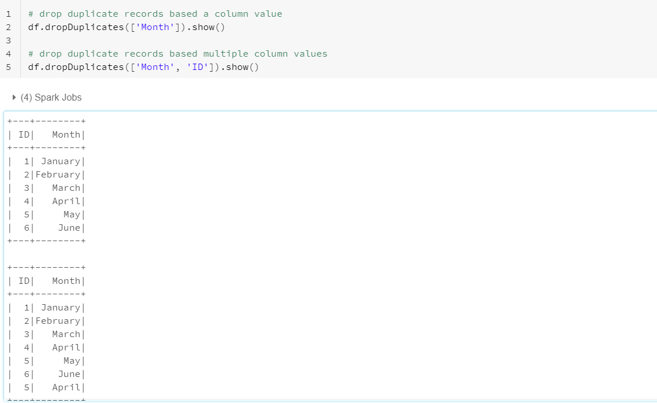
Dropping Duplicate Rows
3

Slide 94
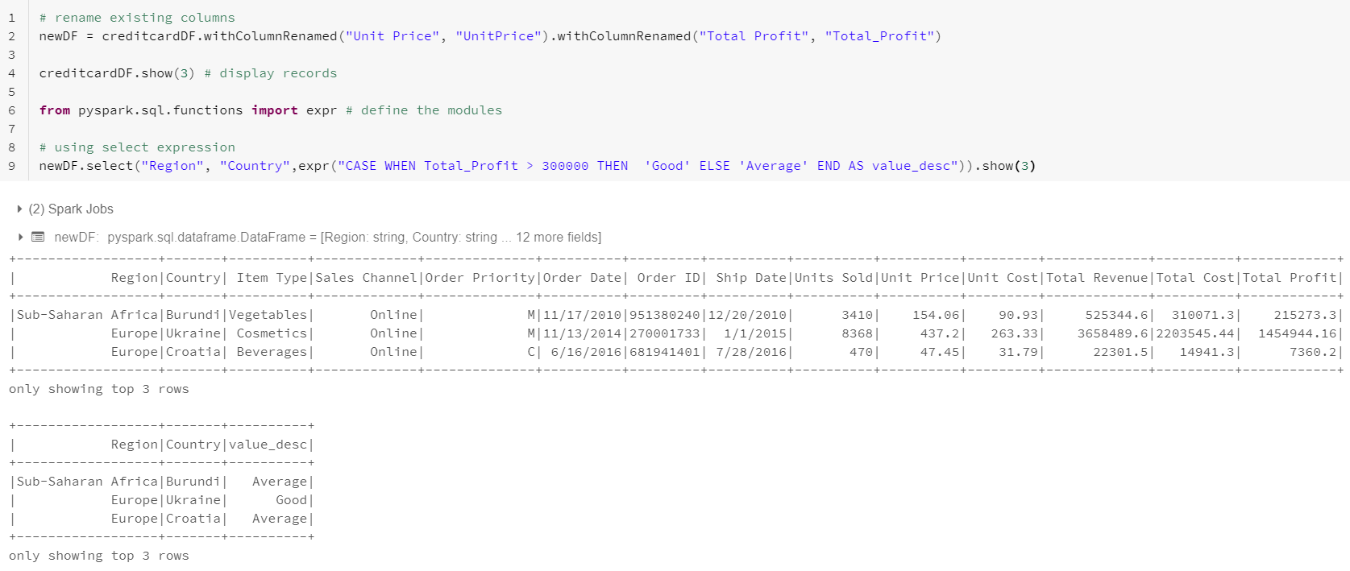
selectExpr

Slide 95
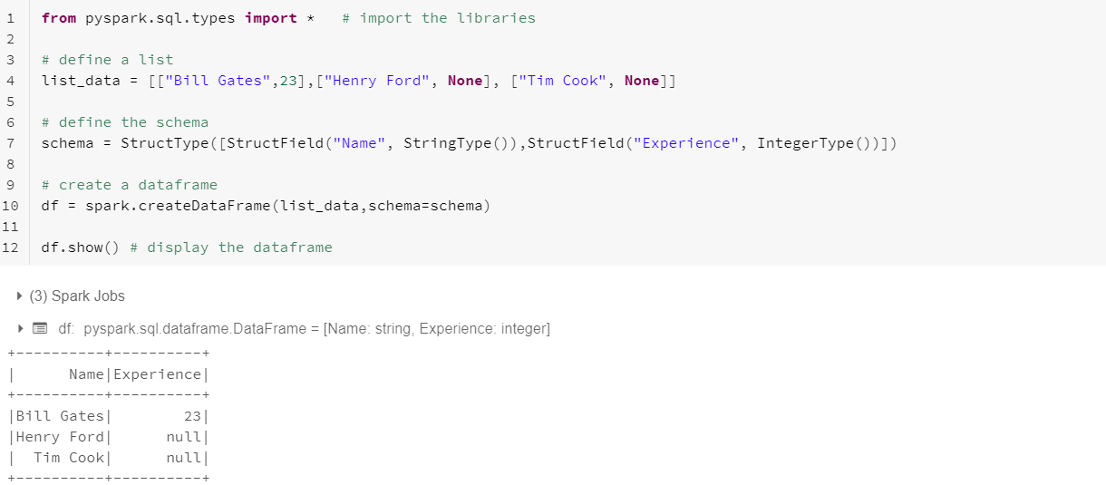
Handling null Values
1

Slide 96


Handling null Values
2

Slide 97


Replacing Values

Slide 98
DataFrame Aggregations
1
A set of methods for aggregations on a DataFrame:
agg
avg
count
max
mean
min
pivot
sum

Slide 99

DataFrame Aggregations
2

Slide 100

DataFrame Aggregations
3

Slide 101

DataFrame Aggregations
4

Slide 102


Ordering DataFrame Rows

Slide 103
Cache and Persist
1
Cache() - defaults storage level to MEMORY_ONLY
Persist() - saves the intermediate results in 5 storage levels:
MEMORY_ONLY
MEMORY_AND_DISK
MEMORY_ONLY_SER
MEMORY_AND_DISK_SER
DISK_ONLY

Slide 104

Cache and Persist
2

Slide 105

Cache and Persist
3

Slide 106
Coalesce and Repartition
1
SNo | Coalesce | Repartition
1 | Reduces the number of partitions | Can be used to either increase or decrease the number of partitions
2 | Uses existing partitions to minimize the amount of data shuffling | Creates new partitions and performs full shuffling
3 | Results in partitions having different sizes | Results in partitions having same size of data

Slide 107

Coalesce and Repartition
2

Slide 108


DataFrameWriter
1
%fs executes the list command (“ls”) and displays all the files in the mentioned folder

Slide 109

DataFrameWriter
2

Slide 110
Class Exercise
Class Exercise
Upload a CSV file in to DBFS (“/FileStore/tables/credit.csv”)
Create a DataFrame by reading CSV file using spark.read.format(“csv”)
Apply DSL methods to perform the below:
Select all columns, and select only a few columns
Rename and drop existing columns
Change the data type of a column from float to double
Replace null values
Apply agg functions
Write the result DataFrame in to DBFS (“/FileStore/tables/result/”)

Slide 111
Spark SQL

Slide 112
Table of Content
What is Spark SQL
Creating Temp View Tables from DataFrames
Querying Temp Views
Apply Aggregations using SQL Queries
Ordering the Records using SQLs
SQL Joins
Writing the results in to DBFS
Class Exercise

Slide 113
Spark SQL
Spark SQL is a Spark module for structured data processing
Provides powerful integration with the rest of the Spark ecosystem
Spark SQL brings native support for SQL to Spark
Provides a programming abstraction called DataFrames
Enables working with structured data, either within Spark programs or through JDBC and ODBC connectors

Slide 114

Create Table from a DataFrame
1

Slide 115

Create Table from a DataFrame
2

Slide 116



Querying the Table

Slide 117

Aggregations

Slide 118


Ordering the Records (Asc, Desc)

Slide 119

Joining the Tables
1

Slide 120

Joining the Tables
2

Slide 121

Saving the Results in to DBFS
1

Slide 122


Saving the Results in to DBFS
2

Slide 123
Thank You

